Slide 1
Conclusion
Testing
Hardware and Software
Scope
Advantage And
Disadvantage
Diagram
Abstract
Limitation
Implementation
Project objective
Comparison existing and proposed

Slide 2
Accident threatens human lives more and mainly road accident is common today. During accident many people lose their life because medical services and family member not getting accidental information on time.
In this paper, an efficient vehicle wireless system is designed and implemented for vehicle accident detection and reporting using accelerometer and GPS. Accelerometer sensor is used to detect crash and GPS give location of vehicle. In case of any accident, the system send automated message to the preprogrammed number such as family member or emergency medical services via GSM.
Conclusion
Testing
Hardware and Software
Scope
Advantage And
Disadvantage
Diagram
Limitation
Abstract
Implementation
Project objective
Comparison existing and proposed

Slide 3
Accident threatens human lives more and mainly road accident is common today. During accident many people lose their life because medical services and family member not getting accidental information on time. In this paper, an efficient vehicle wireless system is designed and implemented for vehicle accident detection and reporting using accelerometer and GPS. Accelerometer sensor is used to detect crash and GPS give location of vehicle. In case of any accident, the system send automated message to the preprogrammed number such as family member or emergency medical services via GSM.
Conclusion
Testing
Whenever accident being met, the nearby people call the ambulance. The problem associated with this is that the victims depend on the mercy of nearby people. There is a chance that there are no people nearby the accident spot or people who are around neglects the accident. This is the flaw in the manual system.
Hardware and Software
Scope
Advantage And
Disadvantage
Diagram
Limitation
Implementation
Project objective
Abstract
Problem statement
Comparison existing and proposed

Slide 4
To design a GPS and GSM based accident identification and information system using PIC.
To trigger the car alarm when accidents are detected.
To interface PIC microcontroller to GSM modem.
To write a program in C programming language for the microcontroller to detect the sensors signals and trigger the alarm as well as send the alert message to owner via GSM modem.
To provide security for the vehicle user and also detects the accident if occurred and informs the respective authority (like ambulance, police, owner etc.) through wireless technologies.
To display the alarm status on 2x16LCD.
Conclusion
Testing
Hardware and Software
Scope
Advantage And
Disadvantage
Diagram
Limitation
Implementation
Project objective
Abstract
Comparison existing and proposed

Slide 5
The first scope is to design a controller that can control all the works in the system. The vibration sensor sense the vibration level and send data to microcontroller and can receive the GPS data, from satellite, display it at LCD and do transmit / receive to GSM module
Second scope of this project is to analysis the data from GPS receiver which can get the time, longitude, latitude, date and speed of the receiver. The data will be display at LCD Display.
Conclusion
Testing
Hardware and Software
Advantage And
Disadvantage
Diagram
Implementation
Scope
Abstract
Limitation
Project objective
Comparison existing and proposed

Slide 6
The following limitations were note during our research;
Difficult for communication in areas with poor coverage of GSM network and GPS communication
Change of car ownership would result in need to reprogram the system details.
Traffic jams can slow down the emergency responders.
Conclusion
Testing
Hardware and Software
Advantage And
Disadvantage
Diagram
Implementation
Scope
Abstract
Project objective
Limitation
Comparison existing and proposed

Slide 7
. To avoid the false alarm we have one manual switch in the vehicle itself which must be pressed within 10 second of false accident detection and hence avoiding any false intimation. We are using front bumper sensor, position encoder along with the accelerometer sensor in order to increase the accuracy of accident detection.
Position encoder is used for calculating the speed of vehicle. The accelerometer sensor as usual tells the microcontroller if there is sudden change in the acceleration. Now a day’s every android phone have inbuilt GPS, GSM modules which we are using in order to get the accident spot location and to send the SMS.
Conclusion
Testing
Hardware and Software
Advantage And
Disadvantage
Diagram
Implementation
Scope
Abstract
Project objective
Limitation
Comparison Between existing and proposed

Slide 8
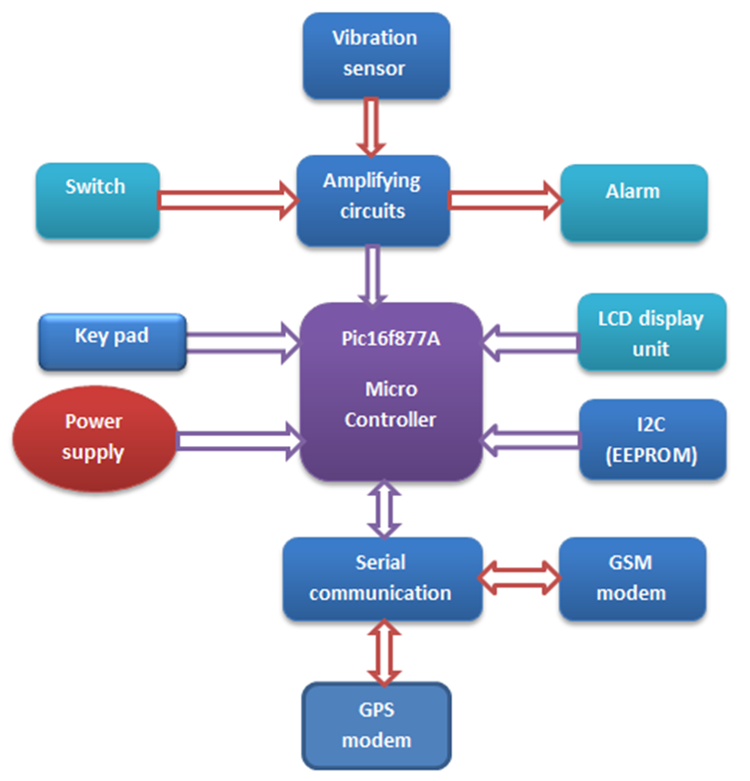
Conclusion
Testing
Hardware and Software
Scope
Advantage And
Disadvantage
Diagram
Abstract
Project objective
Implementation
Limitation
Comparison existing and proposed

Slide 9
This project presents a GPS and GSM based accident identification and information system using GPS and GSM-SMS services. So the main intention of the project is to find the accident spot at any place and intimating it to ambulance through GPS and GSM networks.
The mobile number of the user should be included in the software programming in order to receive the accident location values from the SIM. The aim of our work is to find the vehicle accident location by means of sending a message .
Here one switch is provided to send a message we are safe, when there is no serious injury happen. Due to this we can save the valuable time of emergency medical services.
Then the injured people will be saved as soon as possible.
Conclusion
Testing
Advantage And
Disadvantage
Scope
Hardware and Software
Diagram
Abstract
Project objective
Limitation
Implementation
Comparison existing and proposed

Slide 10
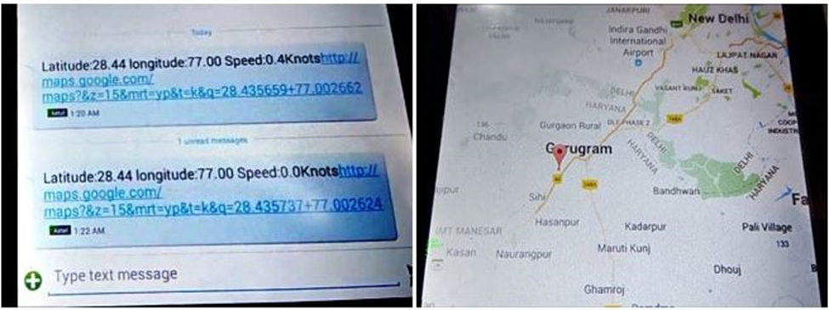
Conclusion
Hardware and Software
Advantage And
Disadvantage
Testing
Scope
Diagram
Abstract
Project objective
Limitation
Implementation
Comparison existing and proposed

Slide 11
HARDWARE REQUIREMENTS:
GSM module
GPS module
Vibration sensor
Pic16f877A microcontroller
Liquid crystal display (LCD)
Key pad
Arduino Uno
Connecting Wires
Breadboard or PCB
Conclusion
Advantage And
Disadvantage
Testing
Scope
Hardware and Software
Abstract
Diagram
Project objective
Limitation
SOFTWARE REQUIREMENTS:
Implementation
Comparison existing and proposed
Arduino compiler
Programming Language: C
GOOGLE MAP
orcad software
serial communication
Proteus simulation software

Slide 12
ADVANTAGE:
Uses some already existing hardware components of mobile phone hence lower the total cost/budget involved.
Use of more than one sensor increases the accuracy of our system.
False alarm switch can avoid any false intimation hence add more towards the reliability.
Conclusion
Testing
Scope
Hardware and Software
Abstract
Advantage And
Disadvantage
Diagram
Project objective
Limitation
Implementation
DISADVANTAGE:
Bluetooth of phone monitors the accident regularly hence takes the power even if no accident being met.
If the phone battery is dead by any means then we can’t intimate to the concerned people.
It does not work without network.
Comparison existing and proposed

Slide 13
CONCLUSION:
This study solves the issues like automatic speed control mechanism, accident detection and information sending. From this we conclude that this system will reduce the accidents and save the human lives.
On the whole this system proves to be very cost effective and efficient. The experimentations and results prove that the system is easily implementable in real time.
Conclusion
Testing
Scope
Advantage And
Disadvantage
Hardware and Software
Abstract
Diagram
Project objective
Limitation
Implementation
Comparison existing and proposed

